Slide 1
Capstone Project
Play Store App Review Analysis By Rishi Kumar Data Science Trainee, AlmaBetter

Slide 2
Problem Statement
Two datasets are provided, one with basic information and the other with user reviews for the respective app.
We must examine and evaluate the data in both datasets in order to
identify the important characteristics that inﬂuence app engagement and success.

Slide 3
Agenda
Introduction
Category wise play store apps installs
Category wise most popular apps
Top 10 apps in play store considering all the parameters
Average installs, category wise
Most installed apps in communication category
Average sizes of apps in each category
Category wise percentage of paid apps
Category wise top installed paid apps
Average rating rating of paid apps
Correlation between Rating ,Installs and Price
Category wise installed apps with content rating
Percentage reviews sentiment distribution

Slide 4
Data Preparation
Loading the data sets: Two datasets, First Play store app
dataset and User Reviews dataset.
Import Libraries: NumPy, Pandas, Seaborn and Matplotlib
Data cleaning: Null values, Finding and removing Outliers, Removing duplicate data.
Data Imputation: Filling the missing categorical values with
mode and numerical values with median. Conversion of price, installs, reviews into numerical values.
Exploratory Data Analysis: Analyzing the data sets to summarize their main characteristics using statistical
graphics and data visualizations method.

Slide 5
Attributes in Google Play store Data 1.App : This column Contains the name of the app for each observation. 2.Category : This column Contains Category to which the app belongs. 3.Rating : This column contains the average rating for the app. 4.Reviews : This column contains the number of reviews that the app has received on the play store. 5.Size : This column contains the amount of memory the app occupies on the device. 6.Installs : This column contains the number of times that the app has been downloaded and installed from the play store. 7.Type : This column contains the information whether the app is free or paid. 8.Price: If the app is a paid app, this column contains the data about its price. 9.Content Rating: This column contains the maturity rating of the app i.e. the age group of the audience for which it is suitable. 10.Genres: This column contains the data about to which genre the app belongs. Genres can be considered as a further division of the group of Category. 11.Last Updated: Contains the date on which the latest update of the app was released. 12.Current Version: Contains information on the current version of the app available on the play store. 13.Android Version: Contains information about the android versions on which the app is supported.

Slide 6
Attributes in User reviews
App- Application name
Translated Review- User review
Sentiment- Positive/Negative/Neutral
Sentiment Polarity- Sentiment polarity score
Sentiment Subjectivity- Sentiment subjectivity score

Slide 7
OVERVIEW OF ANALYSIS
Data Collection and Understanding
Data Cleaning and Manipulation
Exploratory Data Analysis(EDA)

Slide 8
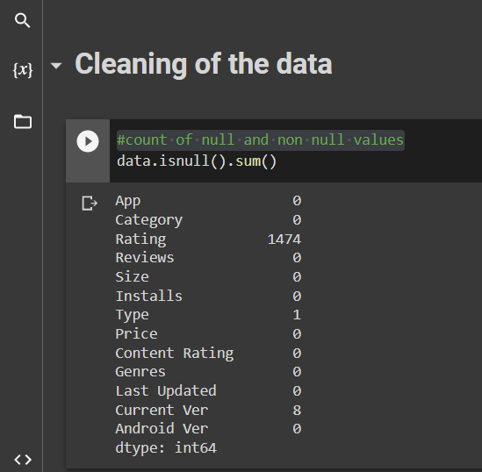
Cleaning the data
We have total (10841, 13) Rows and columns the our data set
First we count the total of null and non null values in the our data

Slide 9
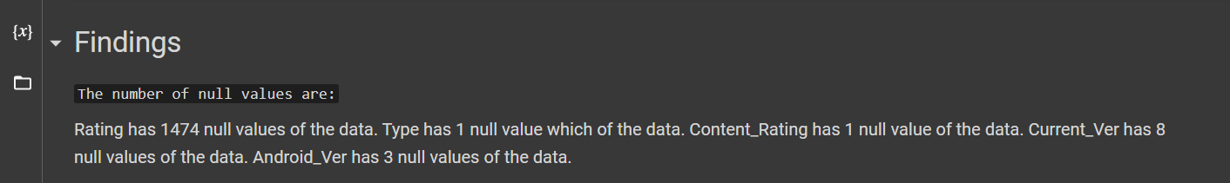

Slide 10
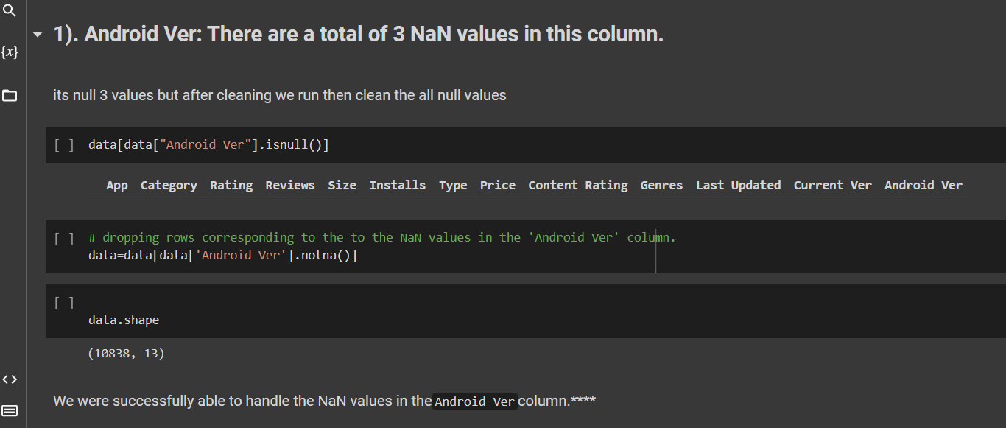

Slide 11
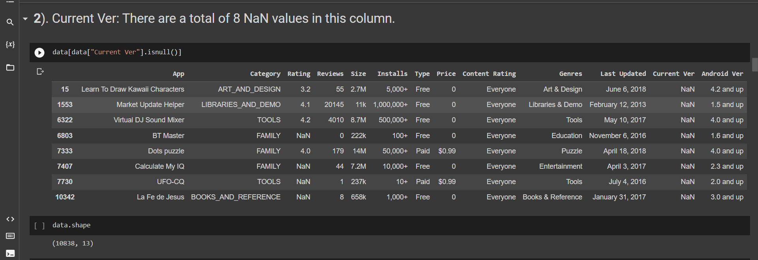

Slide 12
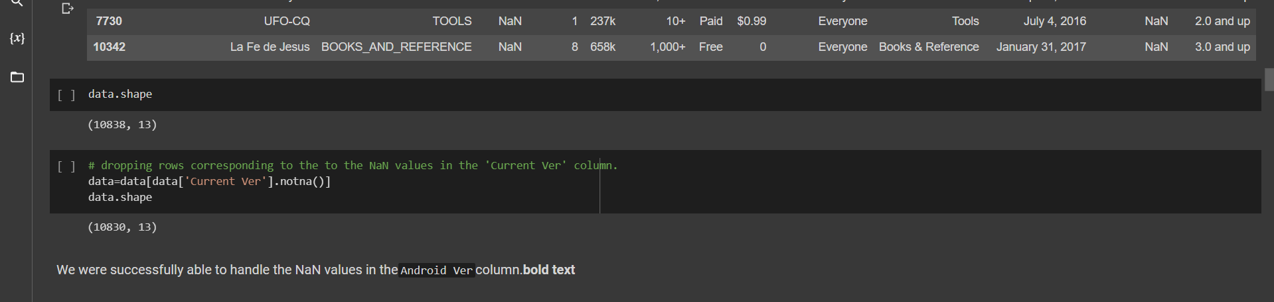

Slide 13
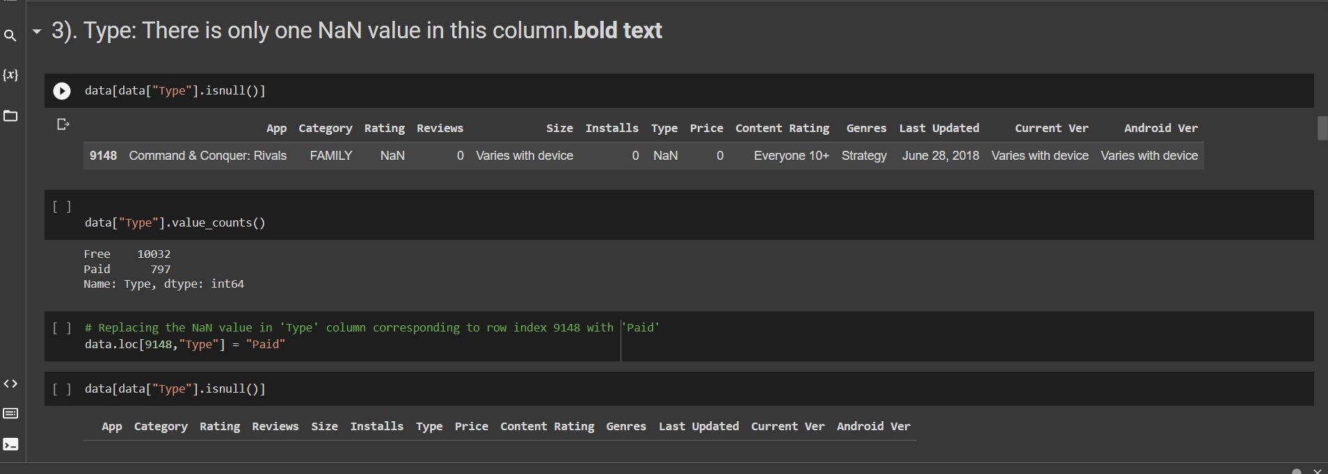

Slide 14
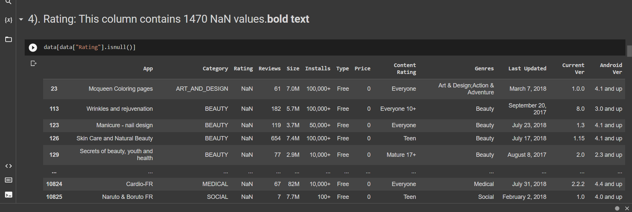

Slide 15
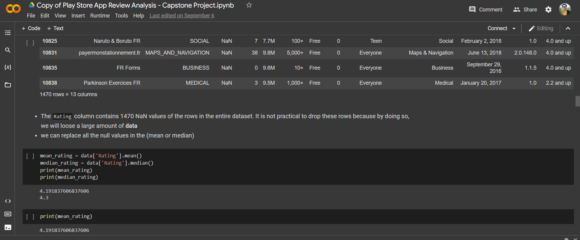

Slide 16
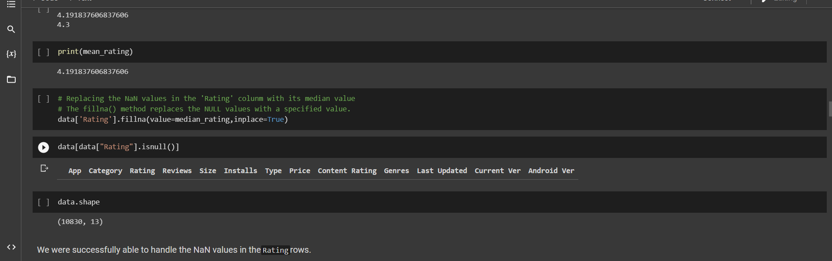

Slide 17
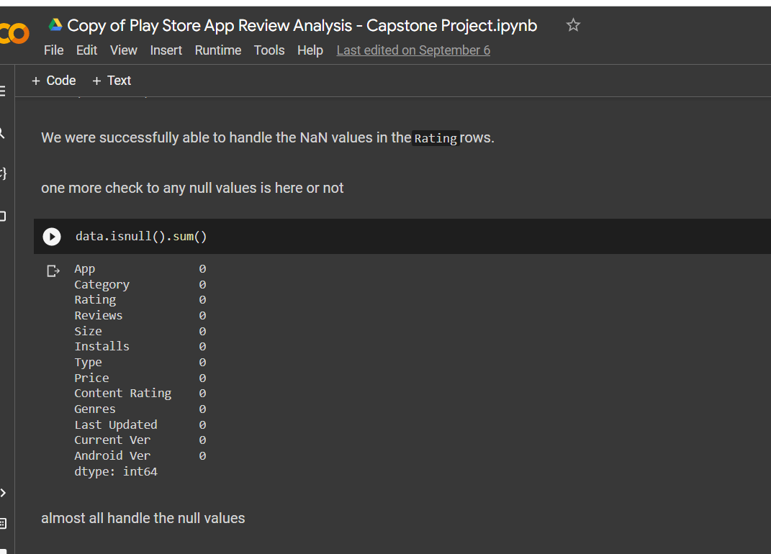

Slide 18
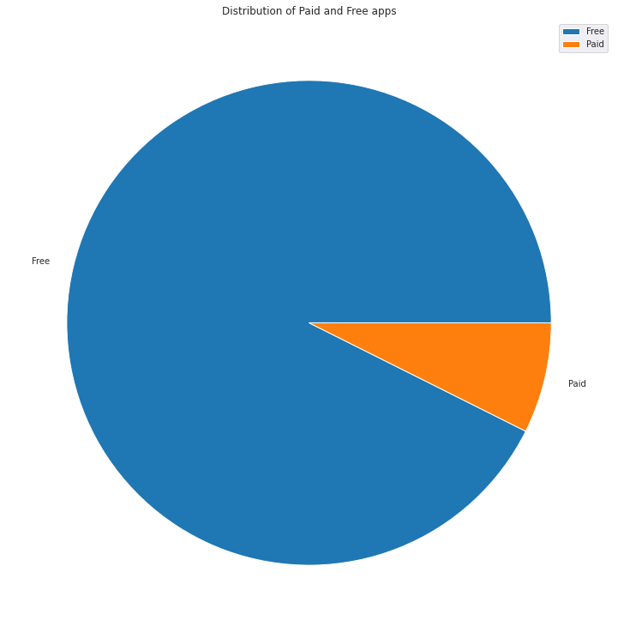
Data Visualization on play store data
1. Percentage of Paid apps v/s Free apps
We Observed that 92.20% of Apps are free and only 7.80% of Apps are paid in Play store.

Slide 19
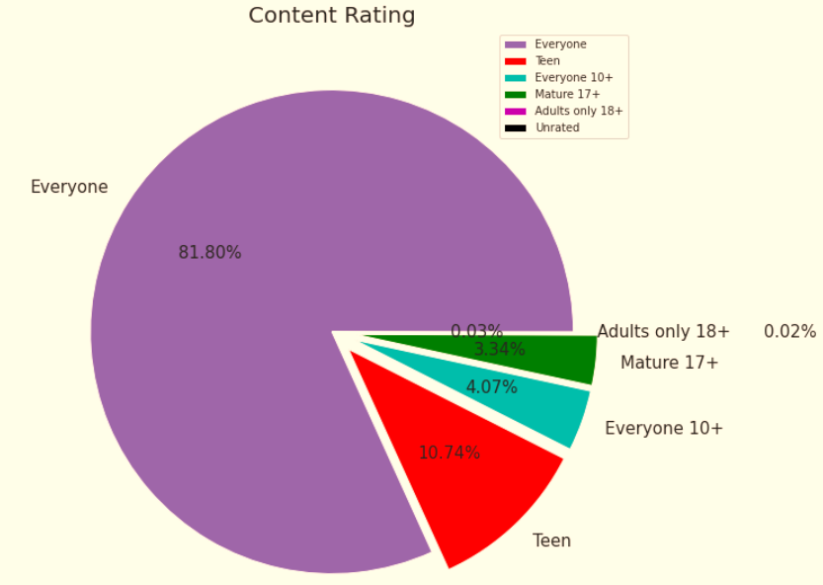
2.Content Rating
From the above plot we can see that Everyone category having majority of apps count.
A majority of the apps (81.80%) in the play store are can be used by everyone. The remaining apps have various age restrictions to use it.

Slide 20

I Take Some Help by This sites :
stack overflow
Greeks for greeks

